Slide 1

Chapter 2
Network Models
2.<number>
Copyright © The McGraw-Hill Companies, Inc. Permission required for reproduction or display.

Slide 2
2-1 LAYERED TASKS
We use the concept of layers in our daily life. As an example, let us consider two friends who communicate through postal mail. The process of sending a letter to a friend would be complex if there were no services available from the post office.
Topics discussed in this section:
Sender, Receiver, and Carrier
Hierarchy
2.<number>

Slide 3

Figure 2.1 Tasks involved in sending a letter
2.<number>

Slide 4
2-2 THE OSI MODEL
Established in 1947, the International Standards Organization (ISO) is a multinational body dedicated to worldwide agreement on international standards. An ISO standard that covers all aspects of network communications is the Open Systems Interconnection (OSI) model. It was first introduced in the late 1970s.
Topics discussed in this section:
Layered Architecture
Peer-to-Peer Processes
Encapsulation
2.<number>

Slide 5

Note
ISO is the organization.
OSI is the model.
2.<number>

Slide 6

Figure 2.2 Seven layers of the OSI model
2.<number>

Slide 7

Figure 2.3 The interaction between layers in the OSI model
2.<number>

Slide 8

Figure 2.4 An exchange using the OSI model
2.<number>

Slide 9
2-3 LAYERS IN THE OSI MODEL
In this section we briefly describe the functions of each layer in the OSI model.
Topics discussed in this section:
Physical Layer
Data Link Layer
Network Layer
Transport Layer
Session Layer
Presentation Layer
Application Layer
2.<number>

Slide 10

Figure 2.5 Physical layer
2.<number>

Slide 11
Note
The physical layer is responsible for movements of
individual bits from one hop (node) to the next.
2.<number>

Slide 12

Figure 2.6 Data link layer
2.<number>

Slide 13
Note
The data link layer is responsible for moving
frames from one hop (node) to the next.
2.<number>

Slide 14

Figure 2.7 Hop-to-hop delivery
2.<number>

Slide 15

Figure 2.8 Network layer
2.<number>

Slide 16
Note
The network layer is responsible for the
delivery of individual packets from
the source host to the destination host.
2.<number>

Slide 17

Figure 2.9 Source-to-destination delivery
2.<number>

Slide 18

Figure 2.10 Transport layer
2.<number>

Slide 19
Note
The transport layer is responsible for the delivery
of a segment from one process to another.
2.<number>

Slide 20

Figure 2.11 Reliable process-to-process delivery of a message
2.<number>

Slide 21

Figure 2.12 Session layer
2.<number>

Slide 22
Note
The session layer is responsible for dialog
control and synchronization.
2.<number>

Slide 23

Figure 2.13 Presentation layer
2.<number>

Slide 24
Note
The presentation layer is responsible for translation, compression, and encryption.
2.<number>

Slide 25

Figure 2.14 Application layer
2.<number>

Slide 26
Note
The application layer is responsible for
providing services to the user.
2.<number>

Slide 27

Figure 2.15 Summary of layers
2.<number>

Slide 28
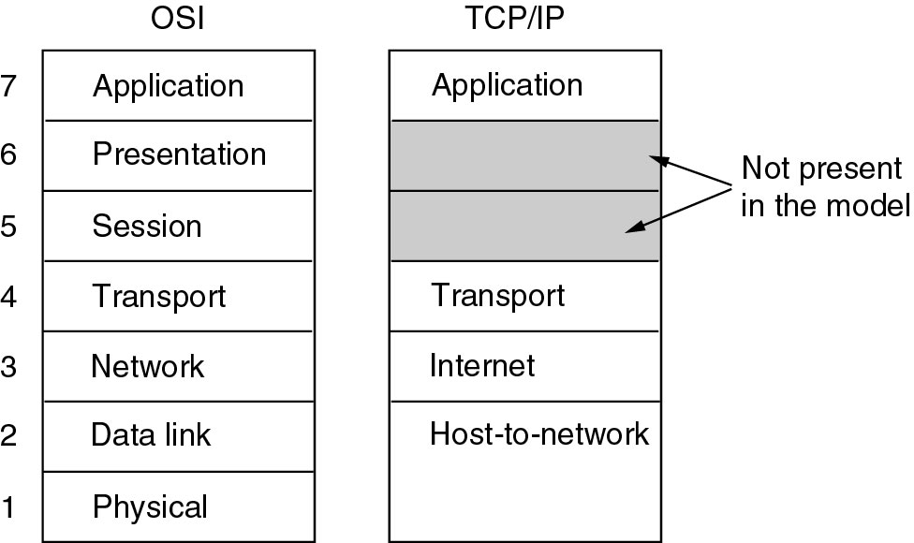
The TCP/IP Reference Model
The TCP/IP reference model.

Slide 29
2-4 TCP/IP PROTOCOL SUITE
The layers in the TCP/IP protocol suite do not exactly match those in the OSI model. The original TCP/IP protocol suite was defined as having four layers: host-to-network, internet, transport, and application. However, when TCP/IP is compared to OSI, we can say that the TCP/IP protocol suite is made of five layers: physical, data link, network, transport, and application.
Topics discussed in this section:
Physical and Data Link Layers
Network Layer
Transport Layer
Application Layer
2.<number>

Slide 30

Figure 2.16 TCP/IP and OSI model
2.<number>

Slide 31
Full Forms: TCP/IP and OSI model
SMTP – Simple Mail Transfer Protocol
FTP – File Transfer Protocol
HTTP – Hyper Text Transfer Protocol
DNS – Domain Name Server
SNMP – Simple Network Management Protocol
SCTP - Stream Control Transmission Protocol
TCP – Transmission Control Protocol
UDP – User Datagram Protocol
ARP - Address Resolution Protocol
RARP - Reverse Address Resolution Protocol
ICMP - Internet Control Message Protocol
IGMP - Internet Group Management Protocol
IP – Internet Protocol
2.<number>

Slide 32
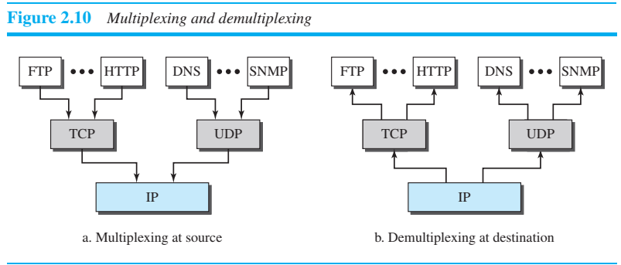
Multiplexing and Demultiplexing
2.<number>

Slide 33
2-5 ADDRESSING
Four levels of addresses are used in an internet employing the TCP/IP protocols: physical, logical, port, and specific.
Topics discussed in this section:
Physical Addresses
Logical Addresses
Port Addresses
Specific Addresses
2.<number>

Slide 34

Figure 2.17 Addresses in TCP/IP
2.<number>

Slide 35

Figure 2.18 Relationship of layers and addresses in TCP/IP
2.<number>

Slide 36
TCP/IP v/s OSI
4 Layers
Did not clearly distinguish between service, interface and protocol.
Protocols in TCP/IP model are not hidden and tough to replace if technology changes.
7 Layers
Distinction between these three concepts are explicit.
Protocols in the OSI model are better hidden than in the TCP/IP model and can be replaced relatively easily as the technology changes.

Slide 37
The protocols came first, and the model was really just a description of the existing protocols.
Designers have much experience with the subject and have clear idea of which functionality to put in which layer.
The model was not biased toward one particular set of protocols, a fact that made it quite general.
Designers did not have much experience with the subject and did not have a good idea of which functionality to put in which layer.

Slide 38
Example 2.1
In Figure 2.19 a node with physical address 10 sends a frame to a node with physical address 87. The two nodes are connected by a link (bus topology LAN). As the figure shows, the computer with physical address 10 is the sender, and the computer with physical address 87 is the receiver.
2.<number>

Slide 39

Figure 2.19 Physical addresses
2.<number>

Slide 40
Example 2.2
As we will see in Chapter 13, most local-area networks use a 48-bit (6-byte) physical address written as 12 hexadecimal digits; every byte (2 hexadecimal digits) is separated by a colon, as shown below:
07:01:02:01:2C:4B
A 6-byte (12 hexadecimal digits) physical address.
2.<number>

Slide 41
Example 2.3
Figure 2.20 shows a part of an internet with two routers connecting three LANs. Each device (computer or router) has a pair of addresses (logical and physical) for each connection. In this case, each computer is connected to only one link and therefore has only one pair of addresses. Each router, however, is connected to three networks (only two are shown in the figure). So each router has three pairs of addresses, one for each connection.
2.<number>

Slide 42

Figure 2.20 IP addresses
2.<number>

Slide 43
Example 2.4
Figure 2.21 shows two computers communicating via the Internet. The sending computer is running three processes at this time with port addresses a, b, and c. The receiving computer is running two processes at this time with port addresses j and k. Process a in the sending computer needs to communicate with process j in the receiving computer. Note that although physical addresses change from hop to hop, logical and port addresses remain the same from the source to destination.
2.<number>

Slide 44

Figure 2.21 Port addresses
2.<number>

Slide 45
Note
The physical addresses will change from hop to hop,
but the logical addresses usually remain the same.
2.<number>

Slide 46
Example 2.5
As we will see in Chapter 23, a port address is a 16-bit address represented by one decimal number as shown.
753
A 16-bit port address represented
as one single number.
2.<number>

Slide 47
Note
The physical addresses change from hop to hop,
but the logical and port addresses usually remain the same.
2.<number>

